Slide 1


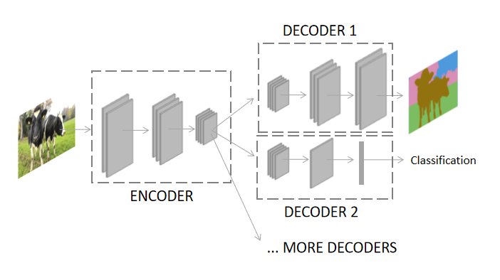
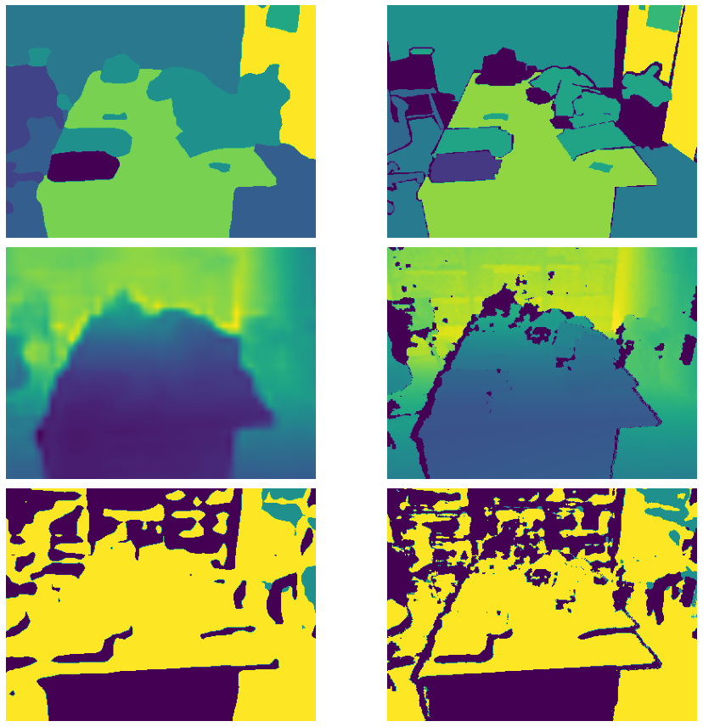
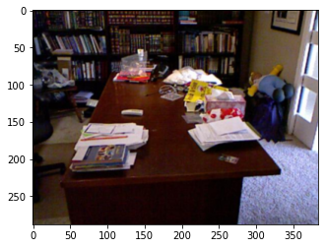
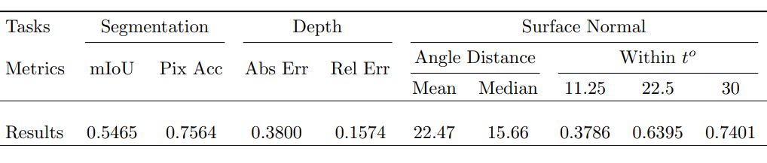
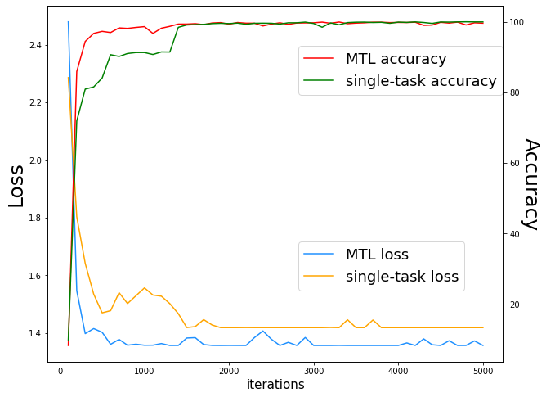
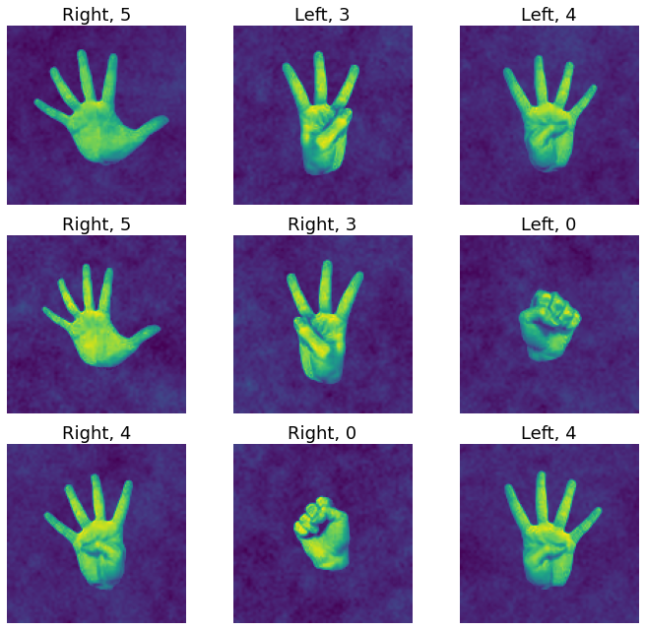
MULTI-TASK LEARNING NNs
Final Project for AMATH 563 - Raphael Liu
WHAT IS MULTI-TASK LEARNING (MTL) ?
Multi-task learning aims to train NNs on different tasks simultaneously, commonly having structures where we have one encoder and multiple decoders. The encoder transforms the input into latent space. The decoders handle specific tasks separately. The proposed architecture is called hard-parameter sharing, and a typical scheme is shown on the right.
A typical hard-parameter sharing architecture. The input image is encoded by a shared encoder. Decoder 1 accomplishes segmentation task. Decoder 2 does classification task. Other related tasks can be present in the meantime.
OVERVIEW
Advantages of MTL
> Multiple output/tasks at once
> Faster convergence
> Better performance
> Less parameters and memory
> Plenty choices of architectures
> Promising for future learning
Recent studies show that MTL is able to improve the performance of related tasks and reduce computational costs.
The computational cost is reduced because in MTL there are shared layers ( or encoders) that learn helpful information from the input. This information helps decoders accomplish specific tasks more efficiently.
MTL can improve the performance of related tasks because MTL strives to learn the relations between tasks. In more carefully designed architectures such as MTAN ( Multi-Task Attention Network), Cross-Stich Network, and DSelect-k, one task’s success can facilitate the other tasks by sharing parameters of the decoder.
I first implement a naive MTL model to solve a toy classification problem in this project. The problem is to count fingers as well as distinguish between left and right hands. A sequential of convolutional layers is used as encoder and FC layers as decoders. The two tasks are learned with a random weighting scheme. Results are shown below:
Input image
From top to bottom: semantic segmentation, depth
estimation, and surface normal prediction. On the right is
ground truth image, and the left is my prediction.
The overall best result is shown in the images and table above. NYUv2 dataset contains 795 training images and 654 validation images. One might expect a better performance after data augmentation, which I didn’t do.
RESULTS on NYUv2
The second part of this project is implementing an MTL model to accomplish 13-class semantic segmentation, depth estimation, and surface normal prediction tasks on the NYUv2 dataset.
The architecture used is MTAN with a ResNet-50 backbone. The weighting scheme used is Random Loss Weighting (RLW).
For the segmentation task, a pixel-wise cross-entropy loss is applied. The L1 (absolute value) loss is calculated for depth estimation and surface normal prediction.
The MTAN architecture, proposed by Shikun Liu (2019), designs attention modules for these three tasks. These modules apply a soft attention mask to particular layers of the shared backbone to learn task-specific features. Therefore, the shared backbone layers contain a global compact features pool across all tasks. Each task explores its specific features from the pool to optimize.
The RLW weighting scheme, proposed by Baijiong Lin (2021), states that we apply random task weights to each task. These random weights sampled from distribution can achieve comparable performance and efficiency. Theoretically, RLW is more likely to escape local minima than the fixed task weights.
LIMITATIONS
There are still possible limitations to MTL. Specifically, one should consider problems such as unbalanced tasks, less related tasks, high memory for heavy decoders, difficulty relating tasks, etc.
> Unbalanced tasks can happen when one task is way easier while another is more subtle and difficult. The easier task requires a light decoder, and it can be fast to converge. But the more challenging tasks require a heavier decoder, which may coverge slowly. The weighting scheme plays a vital role in balancing the tasks by applying corresponding weighting factors.
> Less related tasks can have a significant impact on MTL’s success. When tasks are no longer related, their shared encoder will not provide enough information for some tasks. For those tasks, the performance will drop substantially.
> High memory for heavy decoders can happen when most tasks require a heavy decoder, for instance, segmentation and generating tasks.
> Researches are still ongoing to explore ways to connect tasks. In the future, there will be more various tasks, and it is vital to train the MTL model to learn their relations
First plot shows the training loss and validation accuracy curve of MTL and single-task. The second plot shows the prediction on hand guestures.

